Slide 1
UML - A Brief Look
Unified Modeling Language - UML
  UML grew out of the great variety of ways to design and develop
  object-oriented models and designs
    Mid 1990s
      Number of credible approaches reduced to three
    1997 version 1.1 of UML
      Submitted and accepted by Object Management Group - OMG
    Current version is 2.1

Slide 2
UML - A Brief Look
UML and the Process
  UML Independent of any Software Development Process
    Use Case Driven
    Architecture Centric
    Iterative and Incremental

Slide 3
UML - A Brief Look
UML and the Process
  Each UML Cycle has Four Phases
    Inception
    Elaboration
    Construction
    Transition

Slide 4
UML - A Brief Look
UML and the Process
  Within the Process Five Workflows Cut Across all Phases
    Requirements
    Analysis
    Design
    Implementation
    Test

Slide 5
UML - A Brief Look
UML Diagrams
  UML uses Diagrams and Models
  Lead to a Philosophy of a Model Driven Architecture

Slide 6
UML - A Brief Look
UML Diagrams
  Standard Recognizes 13 Classes of Drawings
    Class Activity
    Use Case Timing
    Object Sequence
    Component Communication
    Interaction Package
    State Chart Composite Structure
    Deployment

Slide 7
UML - A Brief Look
UML Diagrams
  UML diagrams and models reflect
    Static and dynamic relationships amongst classes and class
    instances
  Static Relationships
    Give the architecture of the design
  Dynamic Relationships
    Give the runtime behaviour

Slide 8
UML - A Brief Look
UML Diagrams – Use Cases
  Mechanism for Capturing User Requirements
  Once agreed to by the customer…
  …the use cases become the basis for all further
    Analysis
    Design
    Construction
    Testing
    Deployment

Slide 9
UML - A Brief Look
UML Diagrams – Use Cases
  Gives an outside view of the system
  It describes the public interface for a module or the system
  Answers the Questions…
    What is the Behaviour that the User Sees
    What is the Behaviour that the User Expects

Slide 10
UML - A Brief Look
UML Diagrams – Use Cases - Components
  The Use Case Diagram Comprises Three Components
    The System
    The Actor(s)
    The Use Case(s)

Slide 11
UML - A Brief Look
UML Diagrams – Use Cases
  Has Two views…
    Graphical
    Textual

Slide 12
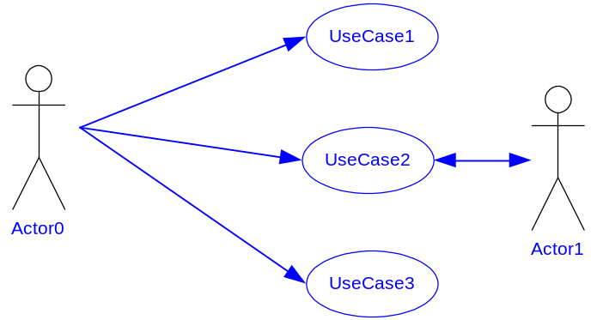
UML - A Brief Look
UML Diagrams – Use Cases – Graphical View
  …A system is viewed as a collection of actors and use cases
    Use Case – A Solid Oval
    Actors – A Figure

Slide 13
UML - A Brief Look
UML Diagrams – Use Cases – Textual View
  …Associated with each use case is a Textual Specification
    Normal Activity
    Exceptional Conditions

Slide 14
UML - A Brief Look
UML Diagrams - Classes
  The class diagram gives a description of…
    The objects in the system
    The relationships amongst them

Slide 15
UML - A Brief Look
UML Diagrams - Classes
  The class diagram specifies
    The public interface to the object
    The properties and operations
    Constraints

Slide 16
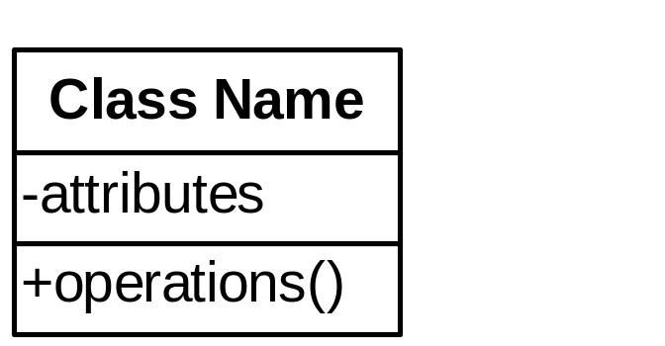
UML - A Brief Look
UML Diagrams - Classes
  A class is collection of objects having the same characteristics
  Classes have
    Names
    Attributes
    Operations

Slide 17
UML - A Brief Look
UML Diagrams – Classes - Attributes
  Attribute Name
    Identifier for the Attribute
    Type
    Associations
  visibility name:type = optional default value

Slide 18
UML - A Brief Look
UML Diagrams – Classes - Attributes
  Operation and Attribute Visibility
    Public – ( + )
      Attribute is visible
        It can be accessed / modified by all objects in the system
    Protected – ( # )
      Attribute is visible
        Within objects of the containing class and all of its subclasses
    Private – ( - )
      Attribute is only visible
        Within objects of the containing class

Slide 19
UML - A Brief Look
UML Diagrams – Classes - Attributes
  Operations
    Identifier for the Attribute
    Type
    Associations
  visibility name(parameter list):return type
    direction name:type = optional default value
      in, out, inout

Slide 20
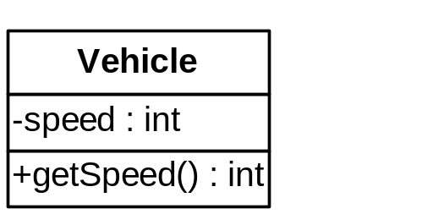
UML - A Brief Look
class Vehicle
{
public:
  Vehicle (String aType)
  {
  vehicleType = aType;
  }
  int getSpeed()
  {
  return speed;
  }
private:
  int speed;
}

Slide 21
UML - A Brief Look
Class Relationships
  We can define number of different relationships among classes
    Relationships
      Parent - Child - call inheritance
      Containment - whole part relationship
        Aggregation
        Composition strong form of aggregation
      Available services

Slide 22
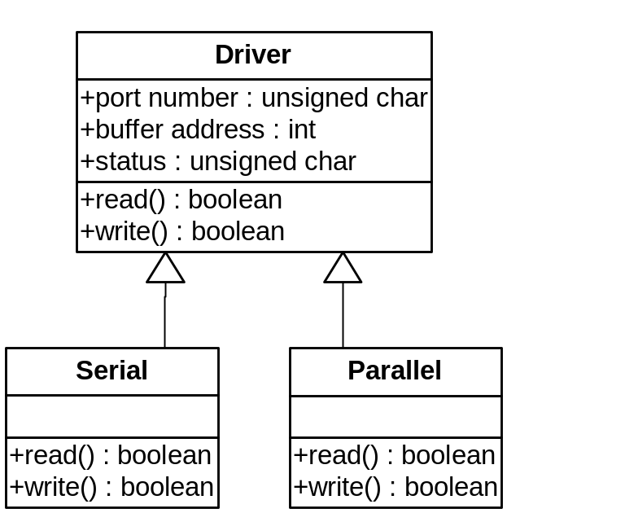
UML - A Brief Look
Class Relationships - Inheritance

Slide 23
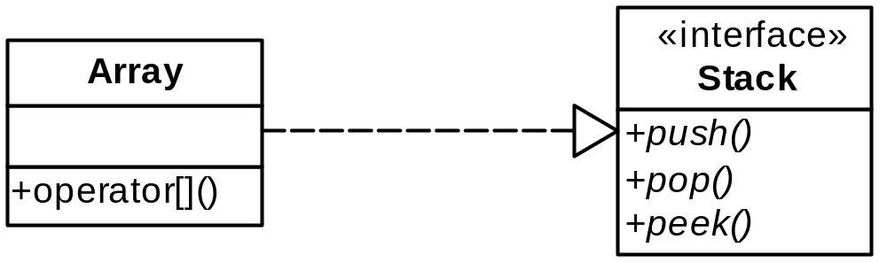
UML - A Brief Look
Class Relationships - Interface

Slide 24
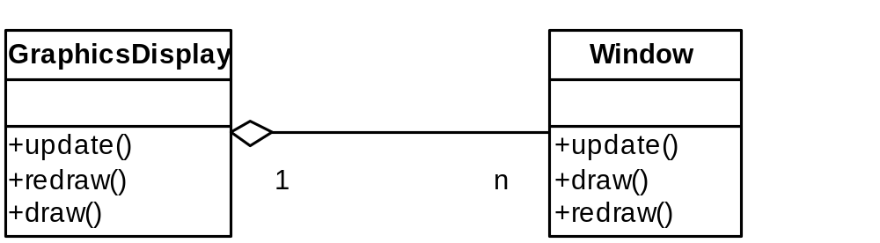
UML - A Brief Look
Class Relationships – Containment - Aggregation

Slide 25
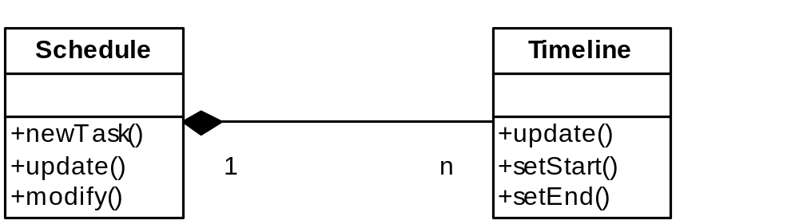
UML - A Brief Look
Class Relationships – Containment - Composition

Slide 26
Bringing Things Together
Traditional Approach
  Analysis
  Design
  Implementation

Slide 27
Analysis
Transformation
Vague
Understanding
Precise Description

Slide 28
Analysis
Emphasis
  Description of what is to be done
  Not how it should be done
  Algorithm selection done later

Slide 29
Design
Design Process
  Structure tasks into
    Classes
    Class Clusters or Libraries
    Identify Jobs – Helper, Supporter, Doer
    Define the ADTs

Slide 30
Design
Goal
  Classes Crisply Defined
  Identify Class Functionality
  Identify Relationships
  Relationships of Manageable Complexity

Slide 31
Design
Result
  Collection of Descriptions
    Each Class
    Class Operation
    Diagrams Showing Relationships
  Tools Available for Support

Slide 32
Design
Finding Classes
  Look for Nouns
    Objects
      State
      Behavior
      Identity
    Consider
      Tangible Things
      Roles
      Events
      Interactions

Slide 33
Design
Finding Operators
  Look for verbs
  Group each operation with one class
  Helpful to have more than one person involved

Slide 34
Design
Finding Relationships
  Use or Awareness
    USES-A
  Aggregation or Containment
    Has-A
  Inheritance or Specialization
    IS-A

Slide 35
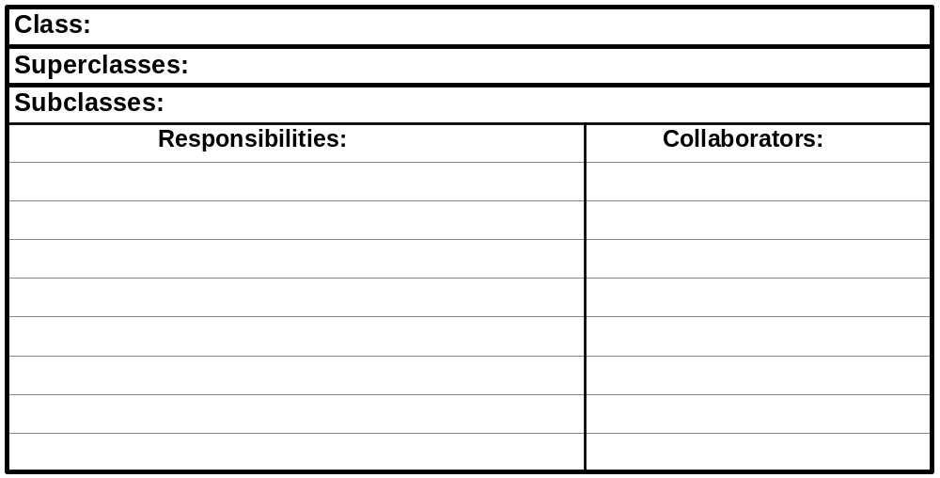
Design
CRC Cards
  Simple technique introduced by Beck and Cunningham
  To help in the Object Discovery phase of object oriented design

Slide 36
Design
Strategy Description
Underline the nouns Gives a first cut at the object list
Identify causal objects Identify the sources of actions, events, and messages
Identify services – passive objects Identify targets of actions, events, and messages
Identify real world items Entities that exist in the real world
Identify physical devices Physical devices are sensors, actuators (buttons), etc.
Identify key concepts May be modeled as objects - may become an abstract base class
Identify transactions Finite instances of associations between objects
that persist for a significant period of time
Identify persistent objects Information that must persist for significant periods of time
Identify visual elements Elements that display data are objects within user interface domain
Identify control elements Control elements are objects that provide the interface for the user
Apply scenarios Walk through using identified objects. Missing should be clear

